Slide 1

University of North Texas
How To Write Papers
Heng Fan
(some personal experiences)
April 21, 2025
Partial content/material adapted from Z. Zhou in NJU.

Slide 2

In the Begining
You all are excellent students!

Slide 3

In the Beginning
A qualified PhD should be able to independently
Come up with ideas
Implement ideas
Finish paper writing
Finish rebuttal
Get paper accepted (somewhere good)

Slide 4
What Is The Goal?
Writing paper is to tell reviewers (and readers):
Problem X is important
Previous works A, B, and C have been done
A, B, and C have their own limitations (e.g., accuracy, efficiency, generality, bias, etc)
Your proposed work D (to address the above limitations)
Experimental and/or theoretic analysis of your method
Comparison with previous works
Why your method D is better
Strength and weakness of D
Future work on D

Slide 5
Paper Structure
Outline of a paper (conference paper as an example):
Title
Abstract
Introduction
Related Work
Your Methodology
Experiments
Conclusion

Slide 6
Paper Structure
Title
Clearly state the key in you paper
Don’t make it too long (usually less than 15 words)
Make it attractive
A good title is as important as the abstract and introduction. It is worth time.

Slide 7
Paper Structure
Title
My strategy: attractive words (optional) + key words + purpose words (optional) + task name (note: the order of these words is flexible)
Some examples of titles in my papers:
Knowing Your Target: Target-Aware Transformer Makes Better Spatio-Temporal Video Grounding (ICLR 2025)
LaMOT: Language-Guided Multi-Object Tracking (ICRA 2025)
Beyond MOT: Semantic Multi-Object Tracking (ECCV 2024)
Tracking Meets LoRA: Faster Training, Larger Model, Stronger Performance (ECCV 2024)
Efficient Multimodal Semantic Segmentation via Dual-Prompt Learning (IROS 2024)
Context-Guided Spatio-Temporal Video Grounding (CVPR 2024)

Slide 8
Paper Structure
Abstract
Purpose: Summarize your contributions
My style (in most cases): writing an abstract by answering questions
Q1: What is the problem to solve in this paper?
Q2: What is your work? (What will you propose?)
Q3: What are the features (keys) of your work?
Q4: What are the advantages of your work?
Q5: What are the results (may show some numbers)?
Sometimes I may simply start from Q2 (leaving Q1 in the introduction)

Slide 9
Paper Structure
Abstract
Examples:
Transformer has attracted increasing interest in STVG, owing to its end-to-end pipeline and promising result. Existing Transformer-based STVG approaches often leverage a set of object queries, which are initialized simply using zeros and then gradually learn target position information via iterative interactions with multimodal features, for spatial and temporal localization. Despite simplicity, these zero object queries, due to lacking target-specific cues, are hard to learn discriminative target information from interactions with multimodal features in complicated scenarios (e.g., with distractors or occlusion), resulting in degradation. Addressing this, we introduce a novel Target-Aware Transformer for STVG (TA-STVG), which seeks to adaptively generate object queries via exploring target-specific cues from the given video-text pair, for improving STVG. The key lies in two simple yet effective modules, comprising text-guided temporal sampling (TTS) and attribute-aware spatial activation (ASA), working in a cascade. The former focuses on selecting target-relevant temporal cues from a video utilizing holistic text information, while the latter aims at further exploiting the fine-grained visual attribute information of the object from previous target-aware temporal cues, which is applied for object query initialization. Compared to existing methods leveraging zero-initialized queries, object queries in our TA-STVG, directly generated from a given video-text pair, naturally carry target-specific cues, making them adaptive and better interact with multimodal features for learning more discriminative information to improve STVG. In our experiments on three benchmarks, TA-STVG achieves state-of-the-art performance and significantly outperforms the baseline, validating its efficacy.
This part informs the reviewers what problem you want to solve in the paper (i.e., addressing what limitations in current works) – could be long (detailed) or short (abstract)
Knowing Your Target: Target-Aware Transformer Makes Better Spatio-Temporal Video Grounding, ICLR, 2025.

Slide 10
Paper Structure
Abstract
Examples:
Transformer has attracted increasing interest in STVG, owing to its end-to-end pipeline and promising result. Existing Transformer-based STVG approaches often leverage a set of object queries, which are initialized simply using zeros and then gradually learn target position information via iterative interactions with multimodal features, for spatial and temporal localization. Despite simplicity, these zero object queries, due to lacking target-specific cues, are hard to learn discriminative target information from interactions with multimodal features in complicated scenarios (e.g., with distractors or occlusion), resulting in degradation. Addressing this, we introduce a novel Target-Aware Transformer for STVG (TA-STVG), which seeks to adaptively generate object queries via exploring target-specific cues from the given video-text pair, for improving STVG. The key lies in two simple yet effective modules, comprising text-guided temporal sampling (TTS) and attribute-aware spatial activation (ASA), working in a cascade. The former focuses on selecting target-relevant temporal cues from a video utilizing holistic text information, while the latter aims at further exploiting the fine-grained visual attribute information of the object from previous target-aware temporal cues, which is applied for object query initialization. Compared to existing methods leveraging zero-initialized queries, object queries in our TA-STVG, directly generated from a given video-text pair, naturally carry target-specific cues, making them adaptive and better interact with multimodal features for learning more discriminative information to improve STVG. In our experiments on three benchmarks, TA-STVG achieves state-of-the-art performance and significantly outperforms the baseline, validating its efficacy.
This part tells the reviewers what your method is roughly about (usually 1-2 sentences).
Knowing Your Target: Target-Aware Transformer Makes Better Spatio-Temporal Video Grounding, ICLR, 2025.

Slide 11
Paper Structure
Abstract
Examples:
Transformer has attracted increasing interest in STVG, owing to its end-to-end pipeline and promising result. Existing Transformer-based STVG approaches often leverage a set of object queries, which are initialized simply using zeros and then gradually learn target position information via iterative interactions with multimodal features, for spatial and temporal localization. Despite simplicity, these zero object queries, due to lacking target-specific cues, are hard to learn discriminative target information from interactions with multimodal features in complicated scenarios (e.g., with distractors or occlusion), resulting in degradation. Addressing this, we introduce a novel Target-Aware Transformer for STVG (TA-STVG), which seeks to adaptively generate object queries via exploring target-specific cues from the given video-text pair, for improving STVG. The key lies in two simple yet effective modules, comprising text-guided temporal sampling (TTS) and attribute-aware spatial activation (ASA), working in a cascade. The former focuses on selecting target-relevant temporal cues from a video utilizing holistic text information, while the latter aims at further exploiting the fine-grained visual attribute information of the object from previous target-aware temporal cues, which is applied for object query initialization. Compared to existing methods leveraging zero-initialized queries, object queries in our TA-STVG, directly generated from a given video-text pair, naturally carry target-specific cues, making them adaptive and better interact with multimodal features for learning more discriminative information to improve STVG. In our experiments on three benchmarks, TA-STVG achieves state-of-the-art performance and significantly outperforms the baseline, validating its efficacy.
This part tells the reviewers what features/keys of your method is (e.g., your proposal modules/strategies/…, usually 2-4 sentences)
Knowing Your Target: Target-Aware Transformer Makes Better Spatio-Temporal Video Grounding, ICLR, 2025.

Slide 12
Paper Structure
Abstract
Examples:
Transformer has attracted increasing interest in STVG, owing to its end-to-end pipeline and promising result. Existing Transformer-based STVG approaches often leverage a set of object queries, which are initialized simply using zeros and then gradually learn target position information via iterative interactions with multimodal features, for spatial and temporal localization. Despite simplicity, these zero object queries, due to lacking target-specific cues, are hard to learn discriminative target information from interactions with multimodal features in complicated scenarios (e.g., with distractors or occlusion), resulting in degradation. Addressing this, we introduce a novel Target-Aware Transformer for STVG (TA-STVG), which seeks to adaptively generate object queries via exploring target-specific cues from the given video-text pair, for improving STVG. The key lies in two simple yet effective modules, comprising text-guided temporal sampling (TTS) and attribute-aware spatial activation (ASA), working in a cascade. The former focuses on selecting target-relevant temporal cues from a video utilizing holistic text information, while the latter aims at further exploiting the fine-grained visual attribute information of the object from previous target-aware temporal cues, which is applied for object query initialization. Compared to existing methods leveraging zero-initialized queries, object queries in our TA-STVG, directly generated from a given video-text pair, naturally carry target-specific cues, making them adaptive and better interact with multimodal features for learning more discriminative information to improve STVG. In our experiments on three benchmarks, TA-STVG achieves state-of-the-art performance and significantly outperforms the baseline, validating its efficacy.
I usually add this part to emphasize that the importance/advantage of my method – telling reviewers what I can address (for improvements)
Knowing Your Target: Target-Aware Transformer Makes Better Spatio-Temporal Video Grounding, ICLR, 2025.

Slide 13
Paper Structure
Abstract
Examples:
Transformer has attracted increasing interest in STVG, owing to its end-to-end pipeline and promising result. Existing Transformer-based STVG approaches often leverage a set of object queries, which are initialized simply using zeros and then gradually learn target position information via iterative interactions with multimodal features, for spatial and temporal localization. Despite simplicity, these zero object queries, due to lacking target-specific cues, are hard to learn discriminative target information from interactions with multimodal features in complicated scenarios (e.g., with distractors or occlusion), resulting in degradation. Addressing this, we introduce a novel Target-Aware Transformer for STVG (TA-STVG), which seeks to adaptively generate object queries via exploring target-specific cues from the given video-text pair, for improving STVG. The key lies in two simple yet effective modules, comprising text-guided temporal sampling (TTS) and attribute-aware spatial activation (ASA), working in a cascade. The former focuses on selecting target-relevant temporal cues from a video utilizing holistic text information, while the latter aims at further exploiting the fine-grained visual attribute information of the object from previous target-aware temporal cues, which is applied for object query initialization. Compared to existing methods leveraging zero-initialized queries, object queries in our TA-STVG, directly generated from a given video-text pair, naturally carry target-specific cues, making them adaptive and better interact with multimodal features for learning more discriminative information to improve STVG. In our experiments on three benchmarks, TA-STVG achieves state-of-the-art performance and significantly outperforms the baseline, validating its efficacy.
Summarize the experiments (sometimes you can put some numbers here to highlight your method, i.e., setting a new record by achieving 0.76 SUC score, etc)
Knowing Your Target: Target-Aware Transformer Makes Better Spatio-Temporal Video Grounding, ICLR, 2025.

Slide 14
Paper Structure
Abstract
Purpose: Summarize your contributions
My style (in most cases): writing an abstract by answering questions
Q1: What is the problem to solve in this paper?
Q2: What is your work? What will you propose?
Q3: What are the features (keys) of your work?
Q4: What are the advantages of your work
Q5: What are the results (may show some numbers)?
Note 1: My abstract is usually a little long (I prefer detailing the problem to solve). If you want your abstract shorter, you may simply your answers to start from answering Q2.
Note 2: The organization of answers to different questions are different (needing adaption for different papers)

Slide 15
Paper Structure
Abstract
Purpose: Summarize your contributions
My style (in most cases): writing an abstract by answering questions
Q1: What is the problem to solve in this paper?
Q2: What is your work? What will you propose?
Q3: What are the features (keys) of your work?
Q4: What are the advantages of your work
Q5: What are the results (may show some numbers)?
Note 3: Abstract is the most important part of your paper. You need to spend a lot of time on this part (iterative revisions/refinements).
I usually complete abstract in the very beginning (some may leave it in the end), because writing abstract is a thinking process of organizing the whole story and helps the writing of subsequent sections.

Slide 16
Paper Structure
Introduction
Purpose: Background and organization of your story
My style: introduction as an expansion of abstract with additional details and context
Problem X is important
A, B, and C have been done
A, B, and C are limited in accuracy/efficiency/…
The inspiration (optional) and your proposed D
Features/keys and advantages of D
Results
Summary of contributions

Slide 17
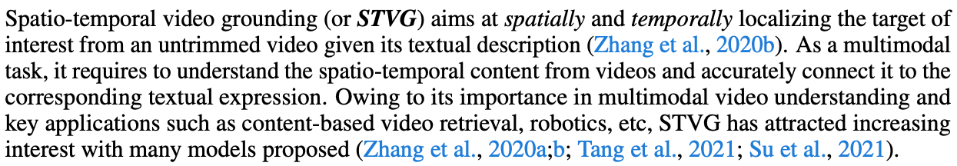
Paper Structure
Introduction
Purpose: Background and organization of your story
My style: introduction as an expansion of abstract with additional details and context
Problem X is important
Introduce what X is; what X is used for; why do we study X
one paragraph

Slide 18
Paper Structure
Introduction
Purpose: Background and organization of your story
My style: introduction as an expansion of abstract with additional details and context
A, B, and C have been done
A, B, and C are limited in accuracy/efficiency/…
Introduce what other works are about; what are their limitations and why they are limited; what are the consequences due to limitations
There might be a lot of prior works. In introduction, you only need to list the very relevant ones
When discussion the limitations, the limitations must be related to what you will address
One paragraph (a little longer maybe – L+)

Slide 19
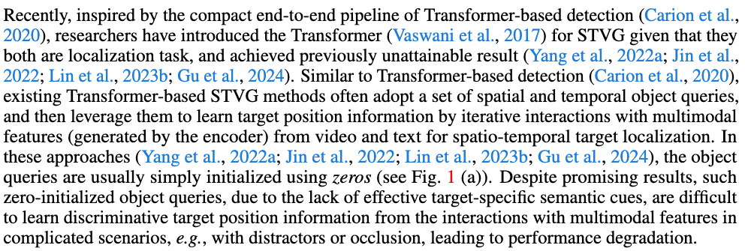
Paper Structure
Introduction
Purpose: Background and organization of your story
My style: introduction as an expansion of abstract with additional details and context
A, B, and C have been done
A, B, and C are limited in accuracy/efficiency/…
Introduce what other works are about; what are their limitations and why they are limited
There might be a lot of prior works. In introduction, you only need to list the very relevant ones

Slide 20
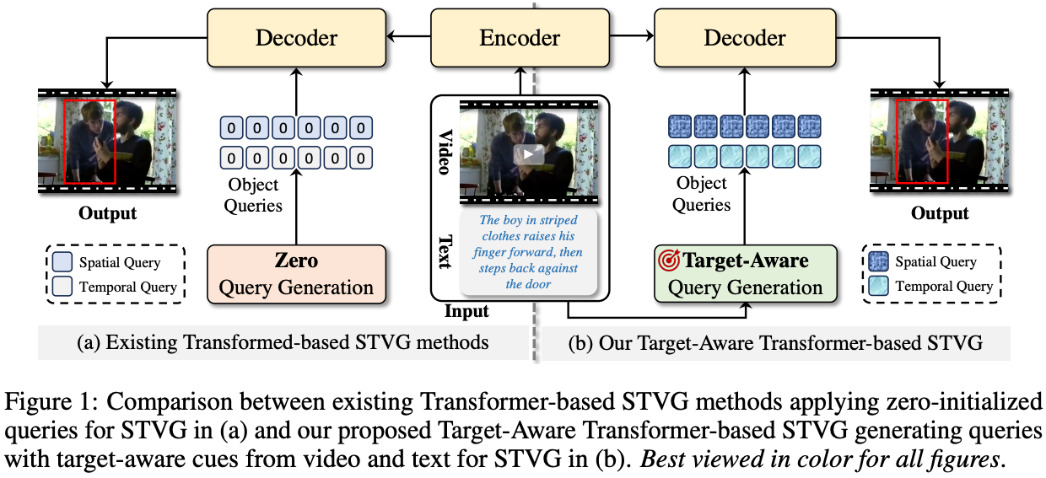
Paper Structure
Introduction
Purpose: Background and organization of your story
My style: introduction as an expansion of abstract with additional details and context
A, B, and C have been done
A, B, and C are limited in accuracy/efficiency/…
Introduce what other works are about; what are their limitations and why they are limited
There might be a lot of prior works. In introduction, you only need to list the very relevant ones
I like adding a figure to highlight the difference between prior works and mine

Slide 21
Paper Structure
Introduction
Purpose: Background and organization of your story
My style: introduction as an expansion of abstract with additional details and context
The inspiration (optional) – I prefer having it in my paper
Let reviewers know how you get or why you propose the idea D.
Note, this part is not about the details of D, b, but a transition stage to your proposed work D.
One paragraph
Your proposed D
Detail the features, keys and advantages of your proposed D
One paragraph (a little bit longer)

Slide 22
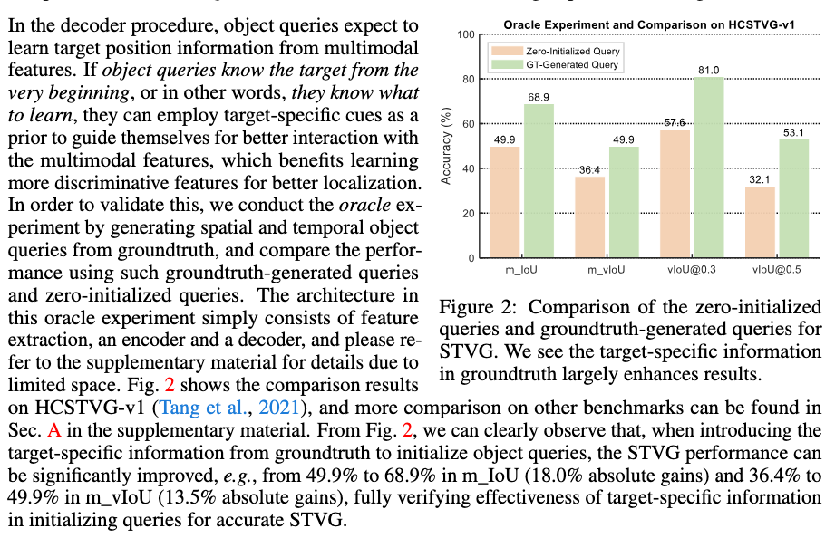
Paper Structure
Introduction
Purpose: Background and organization of your story
My style: introduction as an expansion of abstract with additional details and context
The inspiration (optional) – I prefer having it in my paper
In this inspiration paragraph, I use experiment to tell reviewers a finding, which introduces the following proposed method

Slide 23
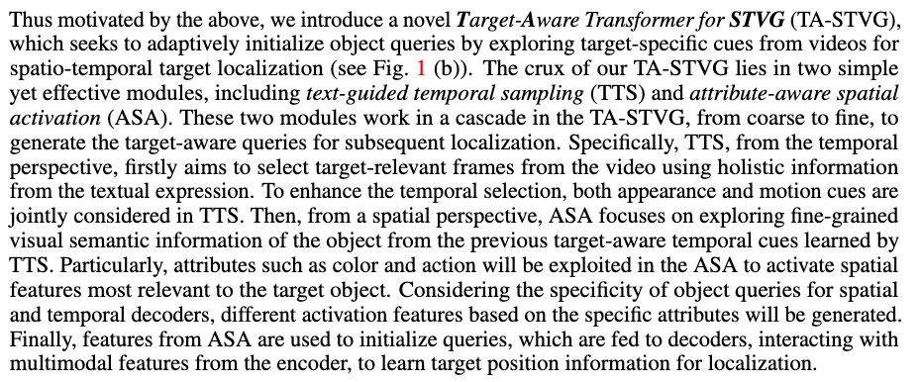
Paper Structure
Introduction
Purpose: Background and organization of your story
My style: introduction as an expansion of abstract with additional details and context
The inspiration (optional) – I prefer having it in my paper
Your proposed D

Slide 24
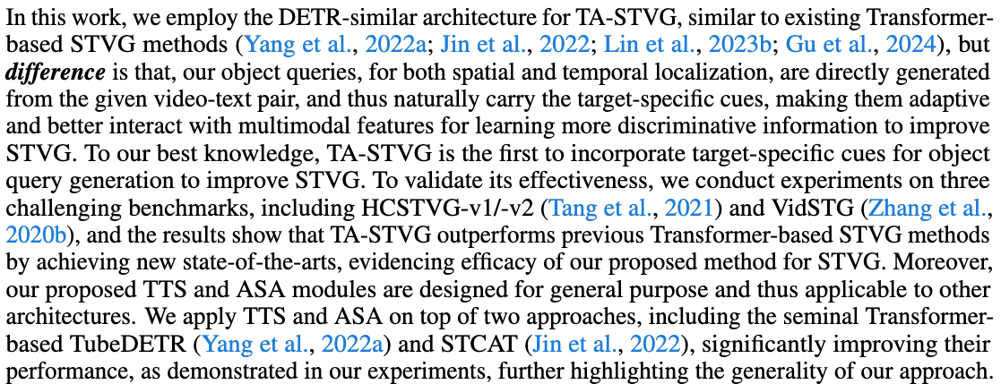
Paper Structure
Introduction
Purpose: Background and organization of your story
My style: introduction as an expansion of abstract with additional details and context
Results
Your proposed D is superior to other approaches
One paragraph

Slide 25
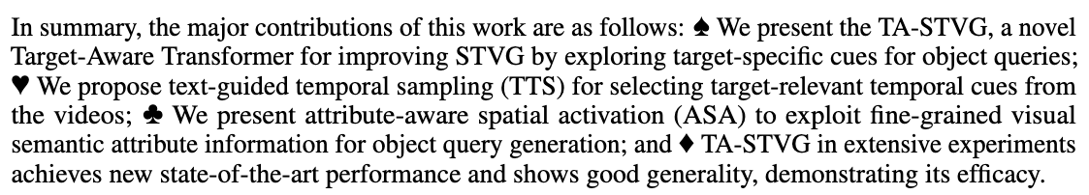
Paper Structure
Introduction
Purpose: Background and organization of your story
My style: introduction as an expansion of abstract with additional details and context
Summary of contributions
Highlight your major contributions
One paragraph
Note: Introduction is as important as abstract. You need to spend a lot of time on this part.

Slide 26
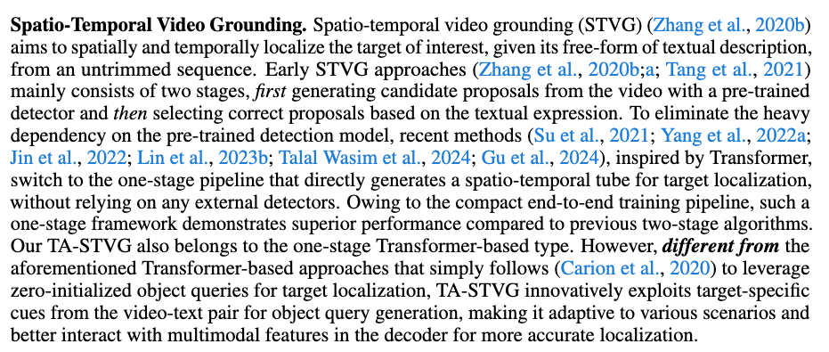
Paper Structure
Related Work
Purpose: Introduce relevant works and illustrate your uniqueness and difference
My style:
Categorization of previous works
Discuss the strength and weakness of each type of methods
Highlight your different in the end
3-4 paragraphs (each paragraph discuss one line of works)
Example of one of paragraphs
I like adding a part to emphasize the difference between other works and mine. This helps reinforce the advantage and uniqueness of your method.

Slide 27
Paper Structure
Your Methodology
Purpose: Introduce your work
There is no single, set style. My style is usually as follows:
An overview paragraph introducing the pipeline (corresponding to an overview figure) – one paragraph
Main part – strategy 1
First introducing the overall framework (could be one subsection, or multiple subsections – depending on your specific method), where your proposed modules (give them cool names) are leveraged
Then detail the proposed modules separately after the framework
Sometimes you may want to add a training objective (loss function) of your framework (this part can be put in supplementary if space is limited)

Slide 28
Paper Structure
Your Methodology
Purpose: Introduce your work
There is no single, set style. My style is usually as follows:
An overview paragraph introducing the pipeline (corresponding to an overview figure) – one paragraph
Main part – strategy 2
Based on the logic of your proposed method, sequentially introducing each of the component
Sometimes you may want to add a training objective (loss function) of your framework (this part can be put in supplementary if space is limited)
The adoption of strategy 1 or 2 depends the specific methodology. The important thing is to make your method clear to reviewers and readers.

Slide 29
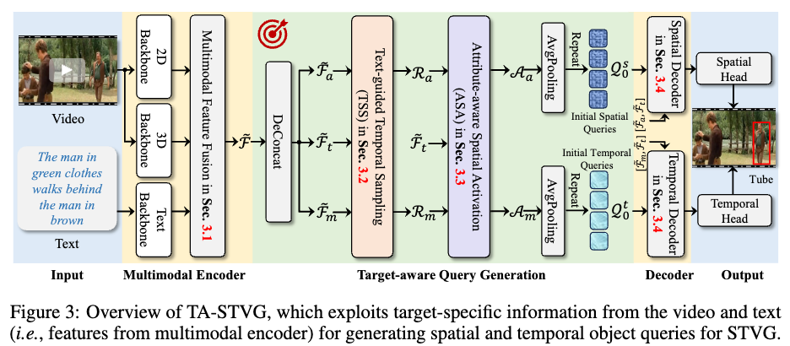
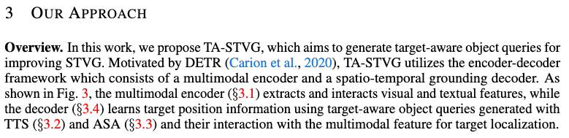
Paper Structure
Your Methodology
Purpose: Introduce your work
There is no single, set style. My style is usually as follows:
Strategy 2: sequentially introducing each component

Slide 30
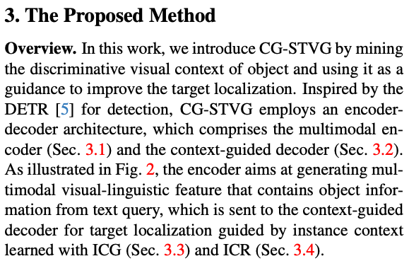
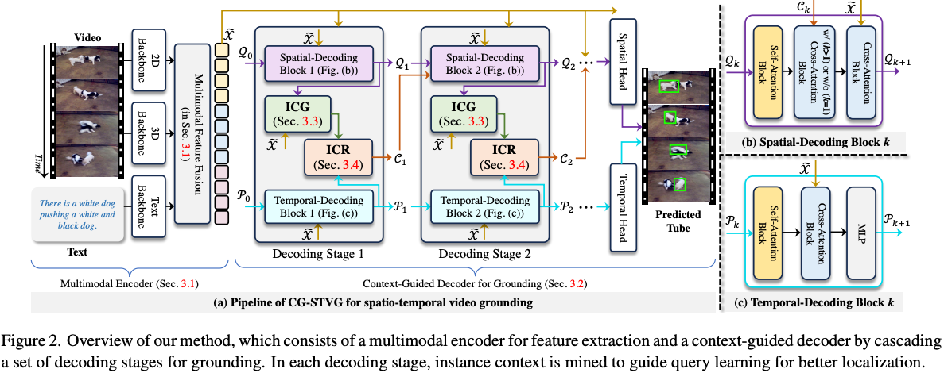
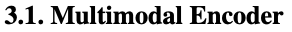
Paper Structure
Your Methodology
Purpose: Introduce your work
There is no single, set style. My style is usually as follows:
framework
proposed modules
Strategy 1: introducing overall framework, then detail proposed modules later

Slide 31
Paper Structure
Experiments
Purpose: Experimental support to your method
My style is usually as follows:
A paragraph for implementation details.
Subsection 1: One or two paragraphs to describe used datasets and evaluation metrics. (this may not necessarily be a subsection; it’s up to you)
Subsection 2: state-of-the-art comparison to other methods.
Subsection 3: Ablation studies of different designs.
Subsection 4: Discussion/analysis (e.g., efficiency, qualitative results, generalization of your method, etc). The discussion of limitation (if there is) is put in the appendix.

Slide 32
Paper Structure
Conclusions
Purpose: Summary and future work
My style is usually as follows:
Summary.
Future work. (sometimes the future work is omitted; but you are suggested to add this for completeness)

Slide 33
Paper Structure
Conclusions
Purpose: Summary and future work
My style is usually as follows:
Summary.
Future work. (sometimes the future work is omitted; but you are suggested to add this for completeness)
Acknowledgement
Reference
Appendix (or supplementary material): put tedious details and additional results/analysis in Appendix

Slide 34



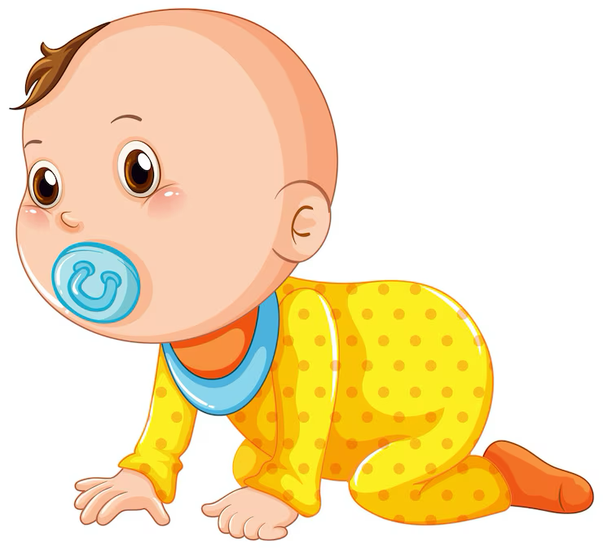
Some Suggestions/Tricks
Learning from other excellent papers (published in top-tier conferences/journals)
Learning not just idea, but also writing
learning
Better and better
Credits: google images

Slide 35

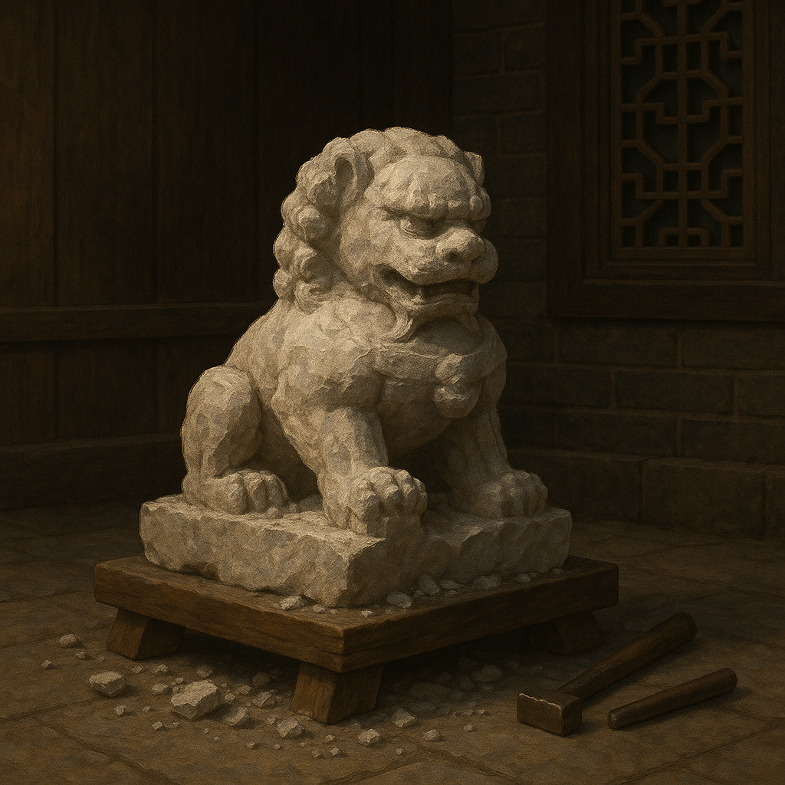

Some Suggestions/Tricks
Revise, revise, and revise
Writing is not a one-time thing; you need to iteratively revise back and forth;
Discuss with your advisor/collaborators, and improve from comments
Start writing as soon as possible; give some time to your advisor and collaborators
Credits: Chatgpt-generated images

Slide 36
Some Suggestions/Tricks
Try to use simple sentences
Scientific writing is not like novel or poem writing; The most important thing is to make every point clear so reviewers and readers can understand it easily.
Write every word on your own
Do NOT copy from other papers (even your own papers). You can rephrase similar statements.
My opinion: Use tools like ChatGPT only when you know how to write papers; don’t use it when you start the learning of writing

Slide 37
Some Suggestions/Tricks
Try to make good-looking figures
These are what you can control in your paper, so try to make them good and give reviewers a good impression
Learn from other papers
Tool: Power Point is good enough to me

Slide 38
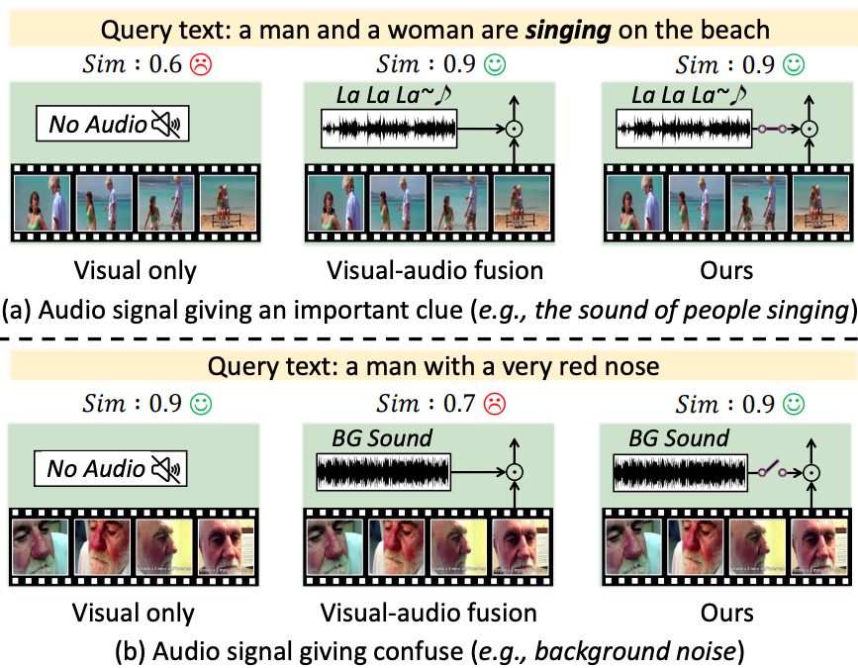
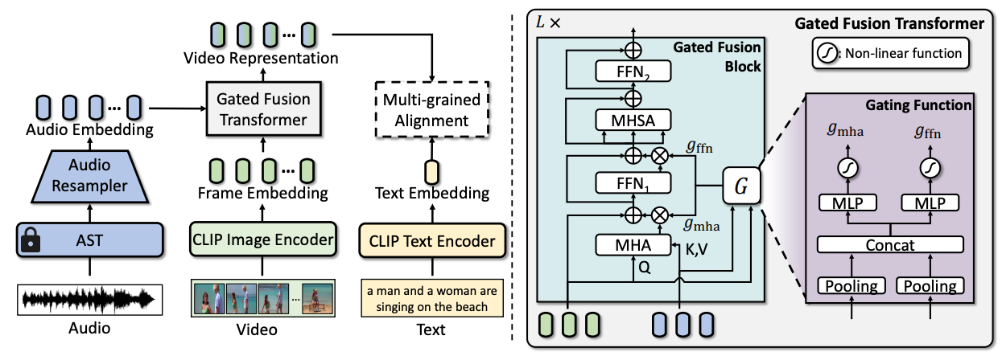
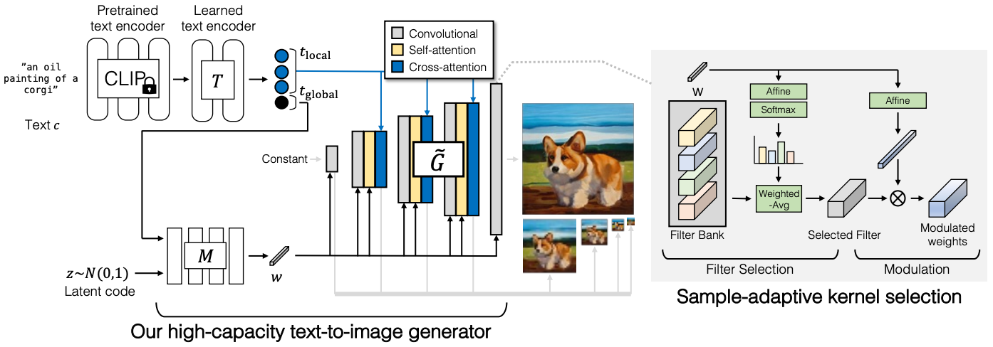
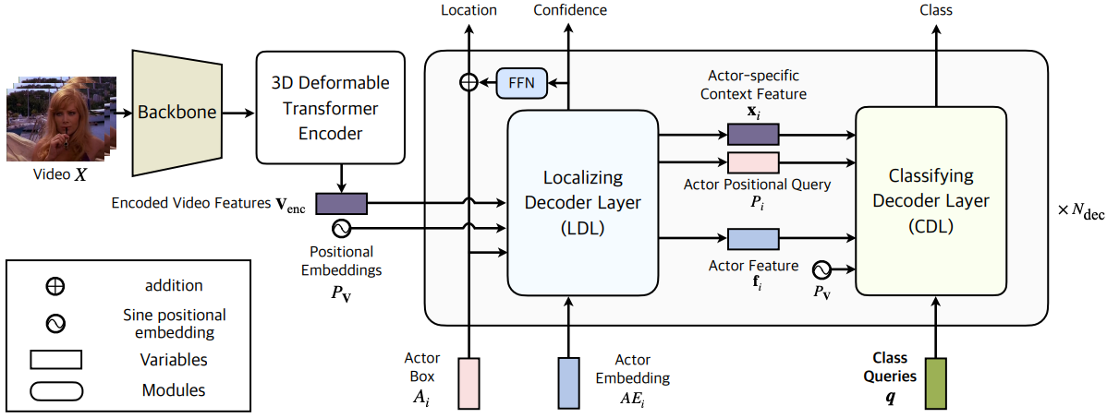
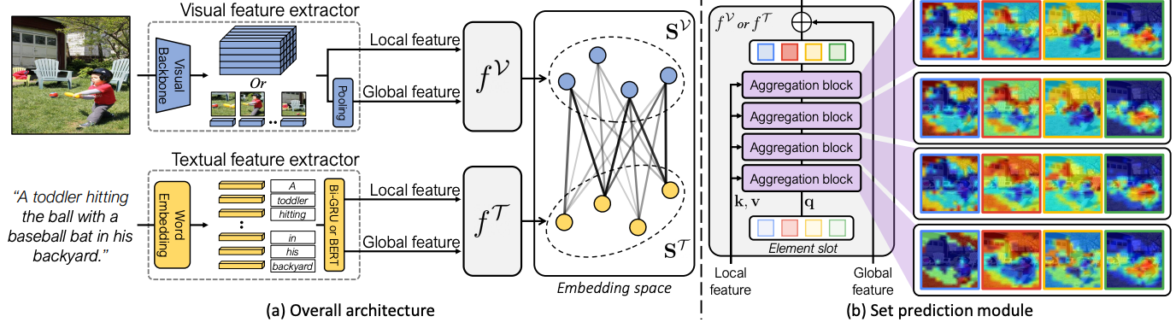
Some Suggestions/Tricks
Try to make good-looking figures
Some examples (not from my paper)

Slide 39
Some Suggestions/Tricks
Try to conduct extensive experiments/analysis
Extensive and solid experiments are crucial (in reviewers’ eye) to justify the effectiveness of your work
Rich ablations are required for analysis
Tables in experiments should be compact and elegant
Highlight your results in tables
Improve readability of your tables in ablations (adding orders)

Slide 40
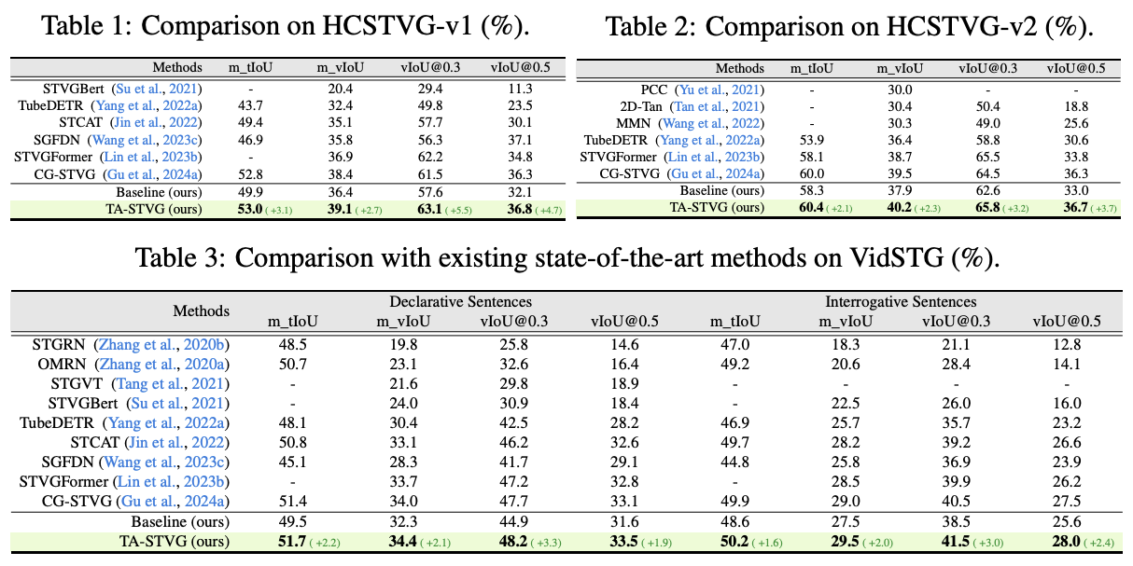
Some Suggestions/Tricks
Try to conduct extensive experiments/analysis

Slide 41
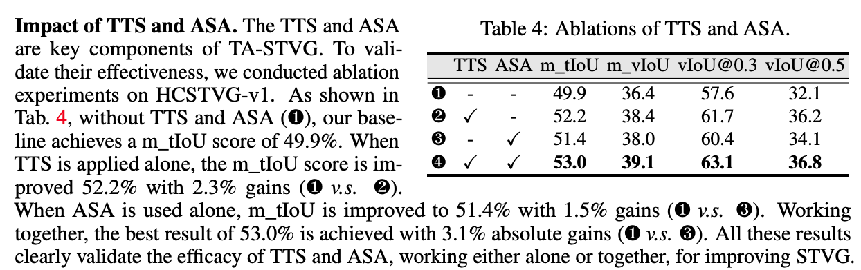
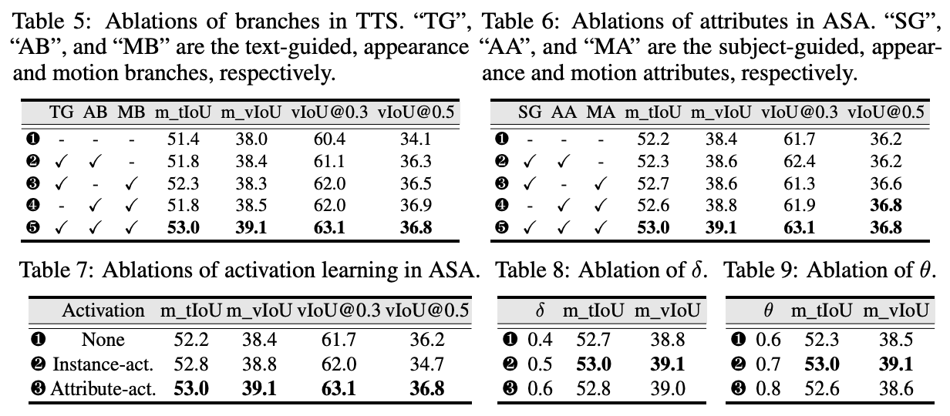
Some Suggestions/Tricks
Try to conduct extensive experiments/analysis

